Slide 1

Module 2- Big Data Infrastructure
Hadoop Ecosystem

Slide 2
Coverage So Far…
Module 1
We have understood Big Data
01
Big Data
So where does it all fit in the bigger scheme of a Big Data architecture
02
HDFS
03
Map Reduce

Slide 3
Module 2
Overview
Hadoop Ecosystem
Sample Big Data Algorithms
HIVE-Case Study
Other Storage: Hbase and Cassandra

Slide 4

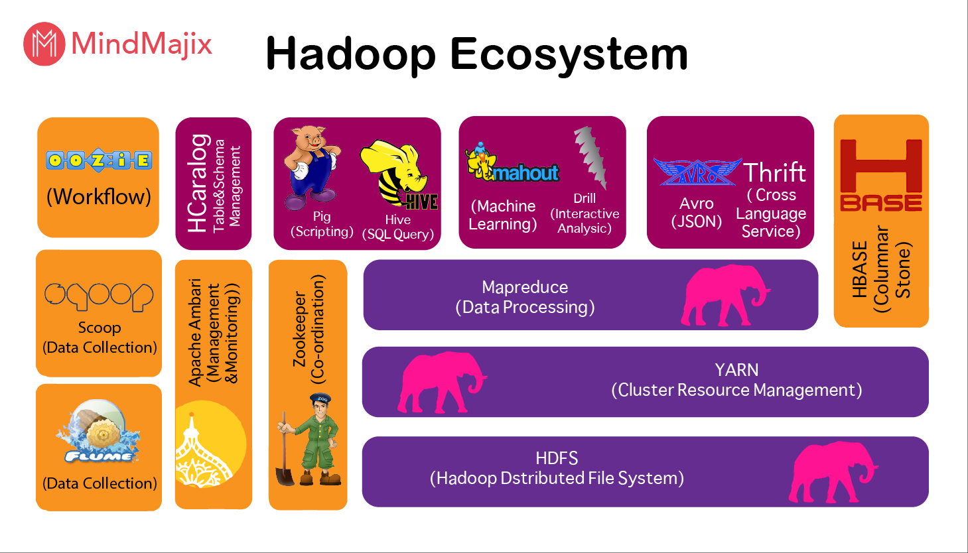
Hadoop Ecosystem
Understand by comparing with conventional Computing

Slide 5
Hadoop Ecosystem
Essential Tools
Pig-scripting tool
HIVE-SQL like query tool
SQOOP-RDBMS tool
Flume-Tool to capture weblog data
OOZIE-Workflow Manager
HBASE-Distributed Hbase database

Slide 6
Apache Pig

Slide 7
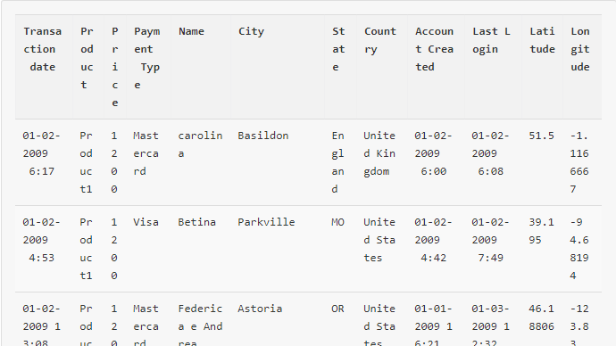

Slide 8
Problem Statement:
Find out number of products sold in Each Country.

Slide 9
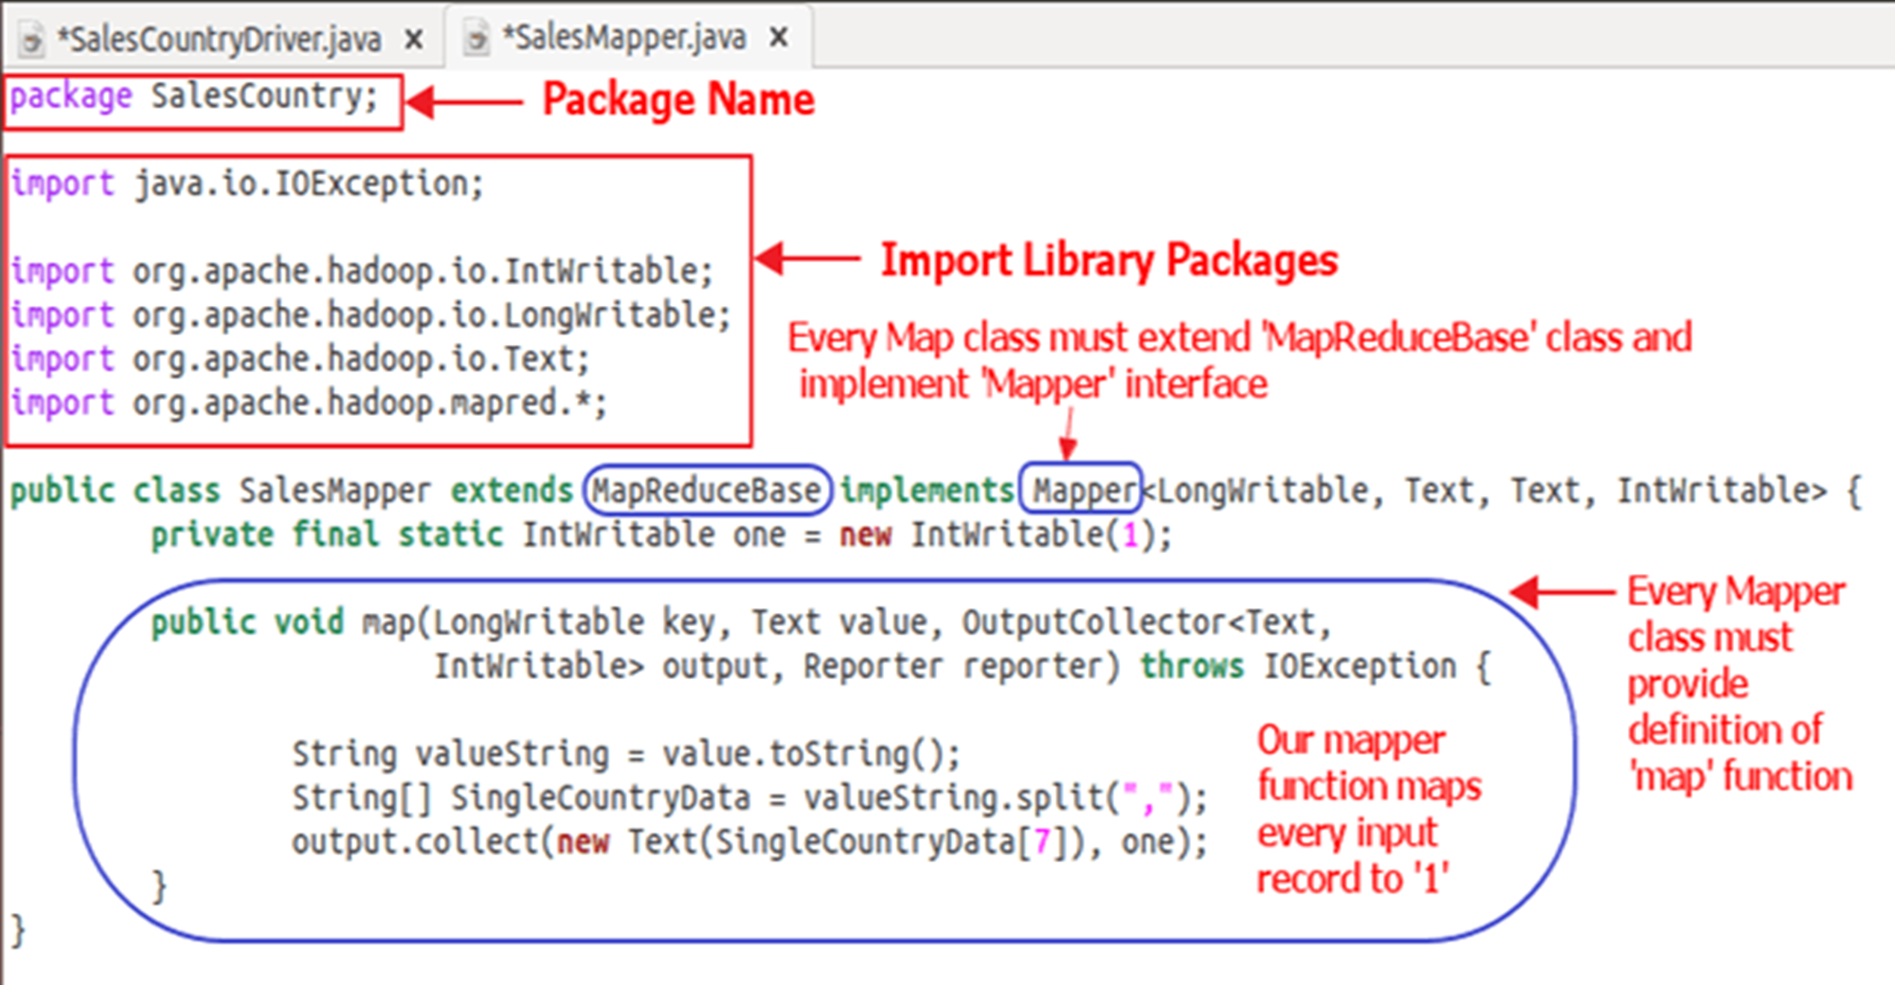

Slide 10
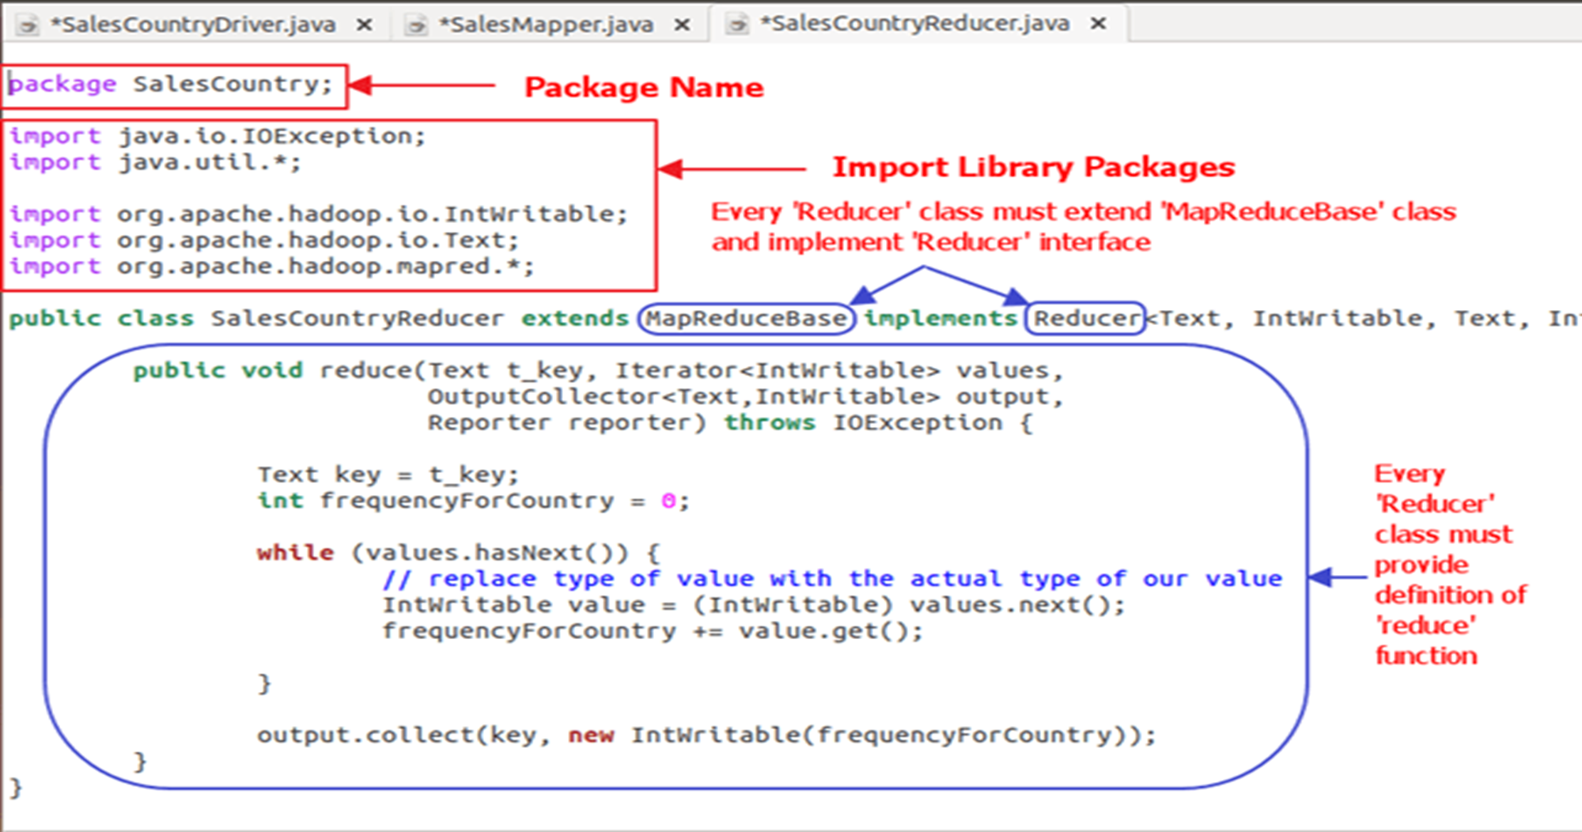

Slide 11
Why Pig?-Limitations of Map reduce
Extremely rigid data flow
Common operations must be coded by hand
Join, filter, aggregates, projection, sorting etc
Semantics hidden inside map reduce functions
Difficult to maintain, extend, and optimize

Slide 12
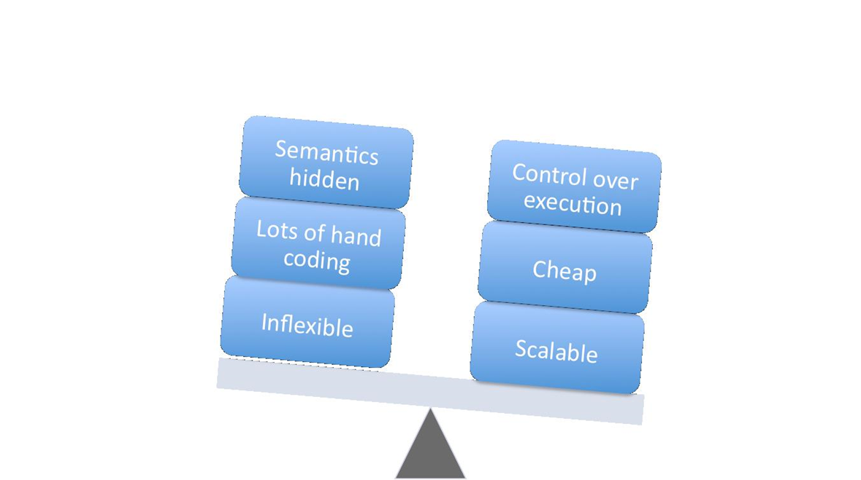
Pros and Cons of Map reduce

Slide 13


Why to go for Pig when Map reduce is there?
Apache Pig | Hadoop Mapreduce
High level data flow tool | Low level data processing paradigm
No need to write complex programs | You need to write programs in Java/Python
Built in support for data operations like joins,filters,ordering,sorting etc | Performing data operations in mapreduce is tedious task
Provides nested data types like tuples,bags and maps | Nested data types are not there in Mapreduce

Slide 14
What is Pig?

Slide 15
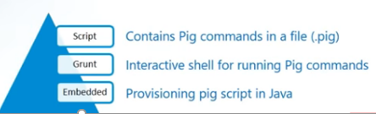

What is Pig?
Apache Pig is a high-level language that enables programmers to write complex MapReduce transformations using a simple scripting language.
Introduced by Yahoo as an open source high level data flow system.
Pig provides abstraction over MapReduce.
Pig includes 2 main components
Pig Latin
Pig Execution

Slide 16
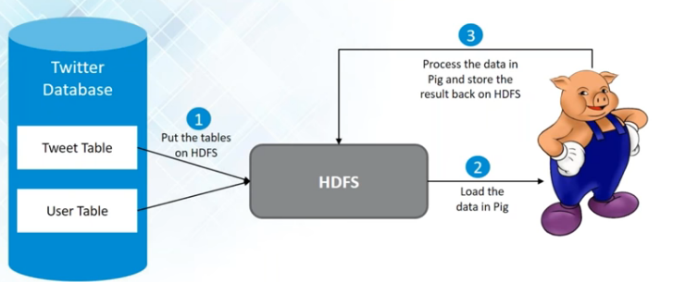
What is Pig Latin?
Pig Latin (the actual language) defines a set of transformations on a data set such as aggregate, join, and sort.
Pig is often used to extract, transform, and load (ETL) data pipelines, quick research on raw data, and iterative data processing.

Slide 17
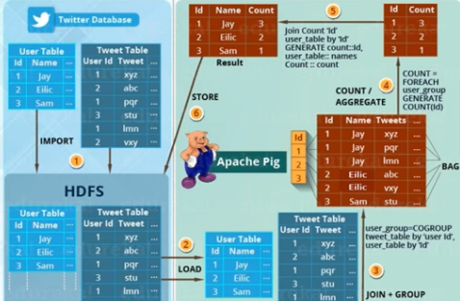

Slide 18
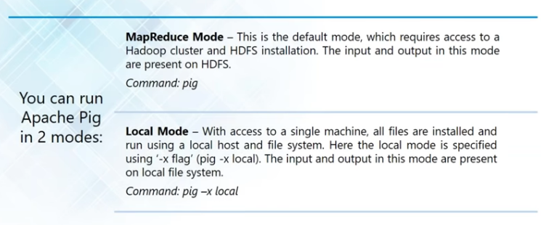
Pig Running Modes

Slide 19
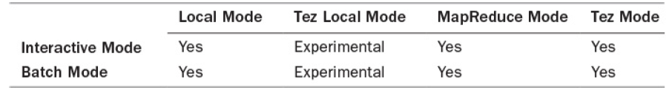
Pig Operating Modes

Slide 20
THANK YOU
“WORLD IS ONE BIG DATA PROBLEM”
“TORTURE THE DATA AND IT WILL CONFESS TO ANYTHING”

